Slide 1
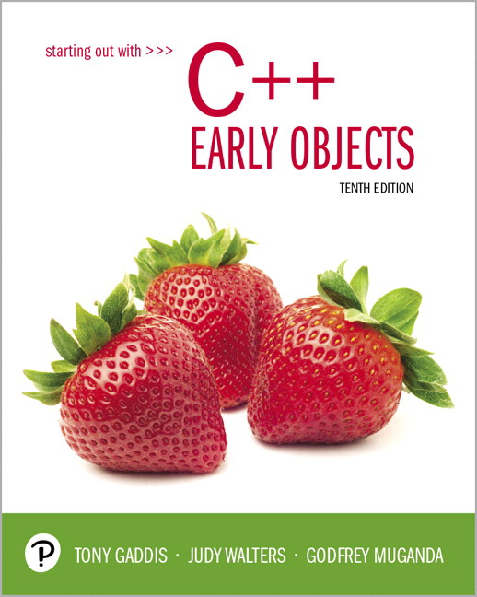
Starting Out with C++ Early Objects
Tenth Edition
Chapter 15
Polymorphism and Virtual Functions

Slide 2
Topics
15.1 Type Compatibility in Inheritance
Hierarchies
15.2 Polymorphism and Virtual Member
Functions
15.3 Abstract Base Classes and Pure Virtual
Functions
15.4 Composition Versus Inheritance

Slide 3
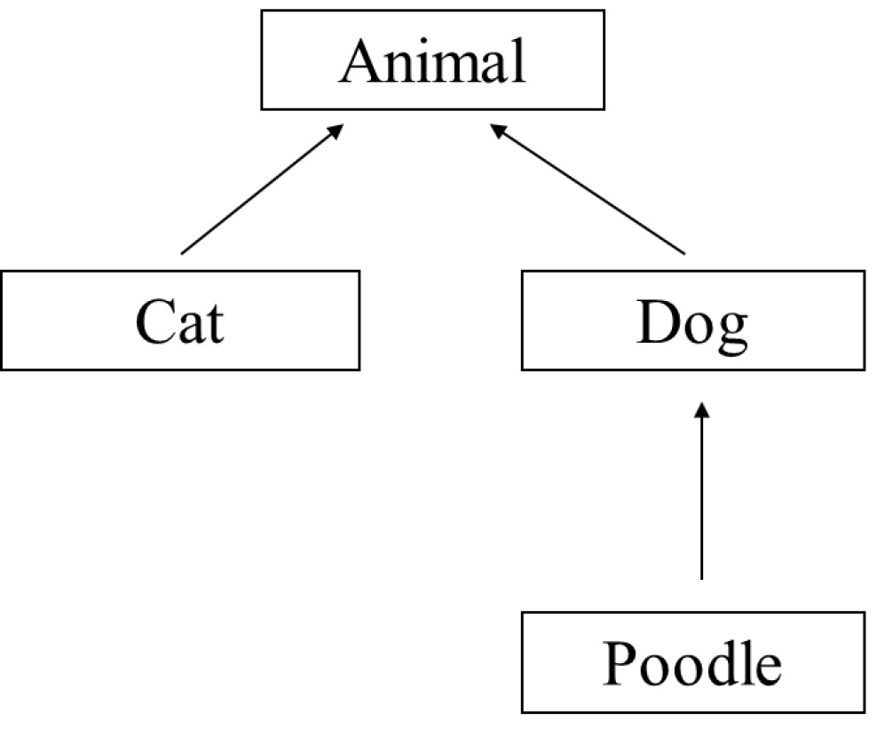
15.1 Type Compatibility in Inheritance Hierarchies
Classes in a program
may be part of an
inheritance hierarchy
Classes lower in the
hierarchy are special
cases of those above

Slide 4
Type Compatibility in Inheritance 1 of 2
A pointer to a derived class can be assigned to a pointer to a base class.
Another way to say this is:
A base class pointer can point to
derived class objects
Animal *pA = new Cat;

Slide 5
Type Compatibility in Inheritance 2 of 2
Assigning a base class pointer to a derived class pointer requires a cast
Animal *pA = new Cat;
Cat *pC;
pC = static_cast<Cat *>(pA);
The base class pointer must already point to a derived class object for this to work correctly.
Notes:
See inheritance4.h and pr15-01.cpp

Slide 6
Using Type Casts with Base Class Pointers
C++ uses the declared type of a pointer to determine access to the members of the pointed-to object
If an object of a derived class is pointed to by a base class pointer, all members of the derived class may not be accessible
Type cast the base class pointer to the derived class (via static_pointer_cast) in order to access members that are specific to the derived class

Slide 7
Pointers, Inheritance, and Overridden Functions
If
a derived class overrides a member function in the base class, and
a base class pointer points to a derived class object,
then
the compiler determines the version of the function to use by the type of the pointer, not by the type of the object.

Slide 8
15.2 Polymorphism and Virtual Member Functions
Polymorphic code: Code that behaves differently when it acts on objects of different types
Virtual Member Function: The C++ mechanism for achieving polymorphism

Slide 9
Polymorphism 1 of 5
Consider the Animal, Cat, Dog hierarchy where each class has its own version of the member function id( )

Slide 10
Polymorphism 2 of 5
class Animal{
public: void id(){cout << "animal";}
};
class Cat : public Animal{
public: void id(){cout << "cat";}
};
class Dog : public Animal{
public: void id(){cout << "dog";}
};

Slide 11
Polymorphism 3 of 5
Consider a collection of different Animal objects
Animal *pA[] = {new Animal, new Dog,
new Cat};
and accompanying code
for(int k=0; k<3; k++)
pA[k]->id();
Prints: animal animal animal, ignoring the more specific versions of id() in Dog and Cat
Notes:
See inheritance4.h and pr15-02.cpp

Slide 12
Polymorphism 4 of 5
The preceding code is not polymorphic: it behaves the same way even though Animal, Dog and Cat have different types and different id() member functions
Polymorphic code would have printed "animal dog cat" instead of "animal animal animal"

Slide 13
Polymorphism 5 of 5
The code is not polymorphic because in the expression
pA[k]->id()
the compiler sees only the type of the pointer pA[k], which is pointer to Animal
The compiler does not see type of actual object pointed to, which may be Animal, or Dog, or Cat

Slide 14
Virtual Functions 1 of 3
Declaring a function virtual will make the compiler check the type of each object to see if it defines a more specific version of the virtual function

Slide 15
Virtual Functions 2 of 3
If the member functions id()are declared virtual, then the code
Animal *pA[] = {new Animal,
new Dog,new Cat};
for(int k=0; k<3; k++)
pA[k]->id();
will print animal dog cat
Notes:
See inheritance5.h and pr15-03.cpp

Slide 16
Virtual Functions 3 of 3
How to declare a member function virtual:
class Animal{
public: virtual void id(){cout << "animal";}
};
class Cat : public Animal{
public: virtual void id(){cout << "cat";}
};
class Dog : public Animal{
public: virtual void id(){cout << "dog";}
};

Slide 17
Function Binding
In pA[k]->id(), compiler must choose which version of id() to use. There are different versions in the Animal, Dog, and Cat classes
Function binding is the process of determining which function definition to use for a particular function call
The alternatives are static and dynamic binding

Slide 18
Static Binding
Static binding chooses the function in the class of the base class pointer, ignoring any versions in the class of the object actually pointed to
Static binding is performed at compile time

Slide 19
Dynamic Binding
With Dynamic Binding, the function to be invoked is determined at execution time
Can look at the actual class of the object pointed to and choose the most specific version of the function
Dynamic binding is used to bind virtual functions

Slide 20
Overriding vs. Overloading
Recall that overloaded functions have the same name but different parameter lists.
Suppose a derived class has a function that overloads a virtual member function in the base class. If you want the derived class function to override the base class function, use the override key word at the end of the function header or prototype. This indicates that it should be treated as an overriding function instead of as an overloading function.
Notes:
See pr15-04.cpp and pr15-05.cpp

Slide 21
The final Key Word and Overriding
The key word final can be used at the end of the header or prototype of a function in an inheritance hierarchy if you want to ensure that no classes below this one override this function.
If an attempt is made to override this function in a derived class, a compiler error will occur.

Slide 22
15.3 Abstract Base Classes and Pure Virtual Functions 1 of 2
An abstract class is a class that contains no objects that are not members of subclasses (derived classes)
For example, in real life, Animal is an abstract class: there are no animals that are not dogs, or cats, or lions…

Slide 23
Abstract Base Classes and Pure Virtual Functions 2 of 2
Abstract classes are an organizational tool. They are useful in organizing inheritance hierarchies
Abstract classes can be used to specify an interface that must be implemented by all subclasses

Slide 24
Pure Virtual Functions 1 of 2
The member functions specified in an abstract class do not have to be implemented
The implementation is left to the subclasses
A function without an implementation is a pure virtual function or an abstract function
In C++, an abstract class is a class with at least one abstract member function

Slide 25
Pure Virtual Functions 2 of 2
In C++, a member function of a class is declared to be an abstract function by making it virtual and replacing its body with = 0;
class Animal
{
public:
virtual void id()=0;
};
Notes:
See pr15-06.cpp

Slide 26
Abstract Classes
An abstract class can not be instantiated
An abstract class can only be inherited from; that is, you can derive classes from it
Classes derived from an abstract class must override all pure virtual functions with concrete member functions in order to be instantiated.

Slide 27
15.4 Composition vs. Inheritance 1 of 2
Inheritance models an 'is a' relation between classes. An object of a derived class 'is a(n)' object of the base class
Example:
an UnderGrad is a Student
a Mammal is an Animal
a Poodle is a Dog

Slide 28
Composition vs. Inheritance 2 of 2
When defining a new class:
Composition is appropriate when the new class needs to use an object of an existing class
Inheritance is appropriate when
objects of the new class are a subset of the objects of the existing class, or
objects of the new class will be used in the same ways as the objects of the existing class
Notes:
See pr15-07.cpp

Slide 29

Copyright

